Slide 1
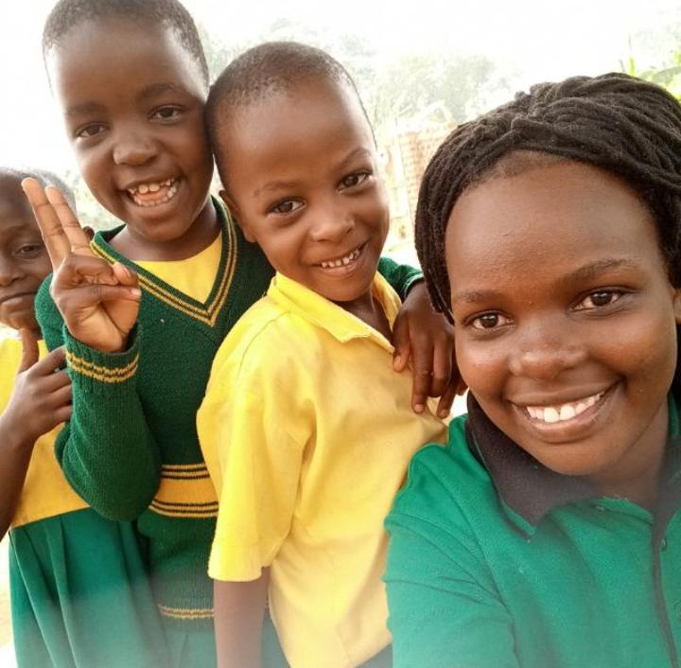
SHAK Junior School Bulabakulu
Key Highlights For 2022
Presented during Virtual Meeting with Klaus on 20/3/22
By Saad Luyinda ,
School Director

Slide 2
SCHOOL ENROLLMENT
Enrollment has increased from 56 in term 1 of 2019 to 202 in 2022.
COVID Depression
2020
2022

Slide 3
Key Developments/Achievements
We have a well constituted team of professional teachers, highly motivated and committed to the excellence of our learners through provision of high quality care and academics.
Our team of teachers increased to 9. Teacher Class Ratio 1:1 ; 8 are full timers.

Slide 4
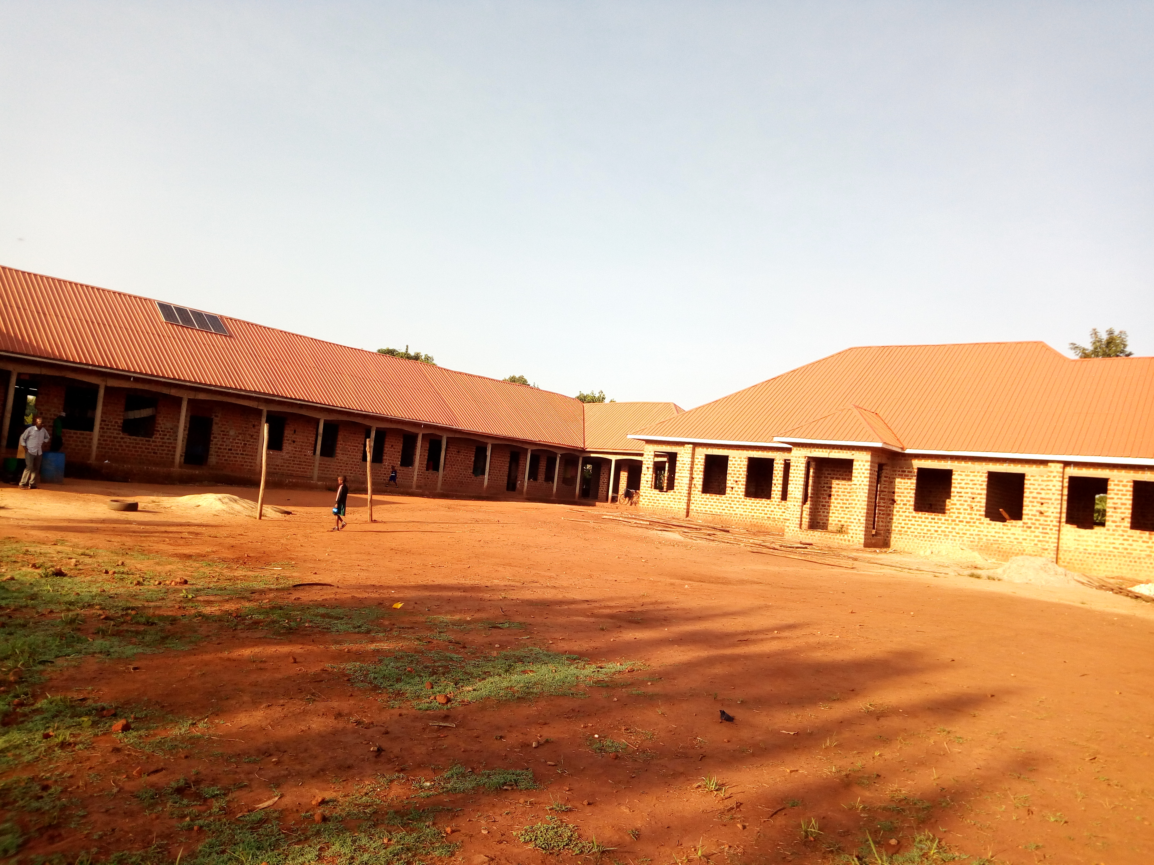
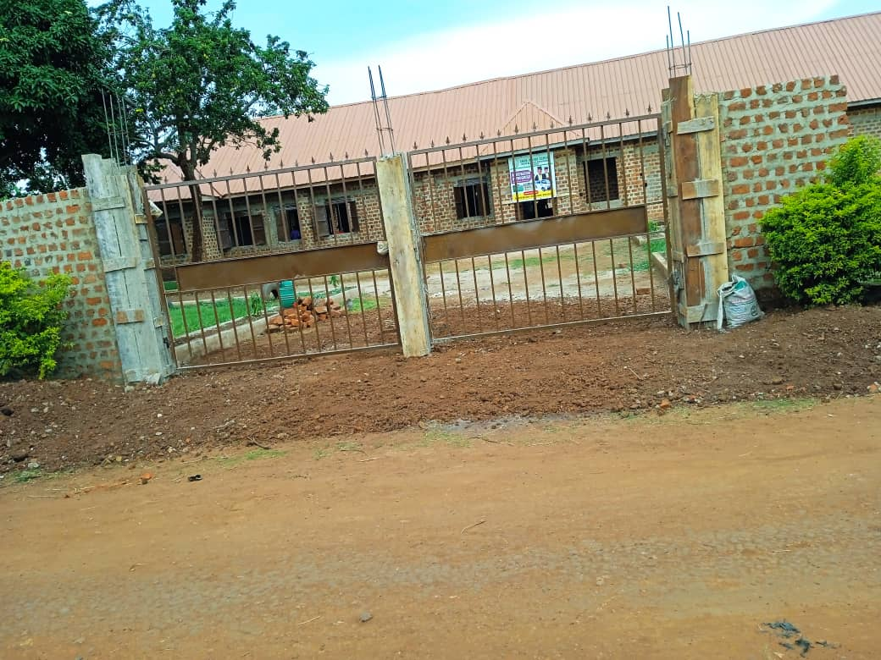
Structural Development
We have successfully managed to expand our physical infrastructure to provide a safe and conducive learning environments to our learners’
Four extra classroom were completed on the old block
Our classrooms currently occupied have cemented floor(2 extra rooms yet to be fixed)
On track to fix window and door shutters for the first block about 45% done

Slide 5
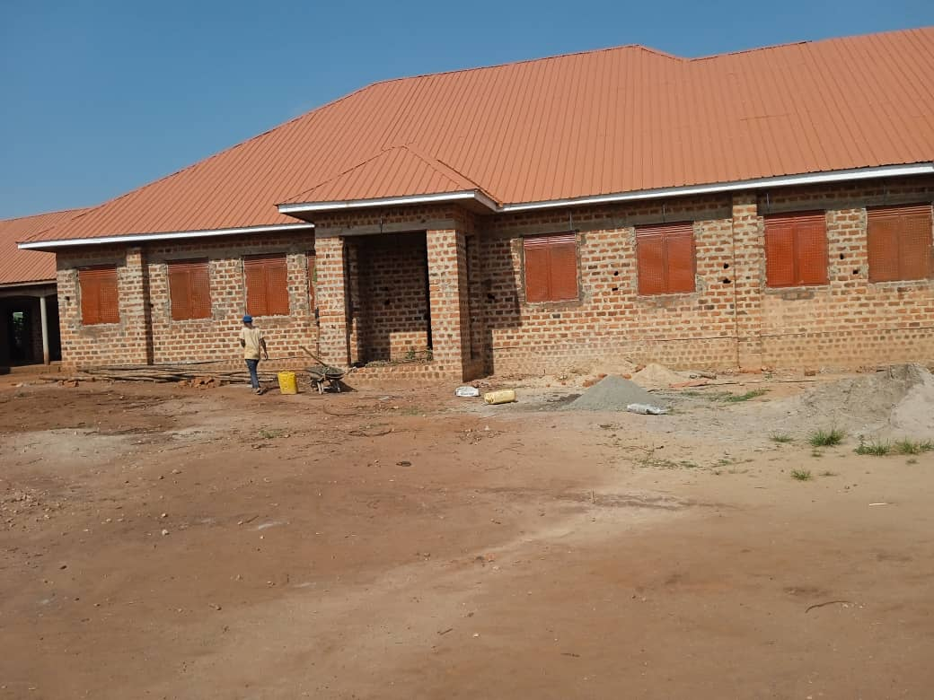
The new Nursery Block
Constructed a new building block for Nursery with a spacious a more spacious environment – works are near completion.
Nursery building: Courtesy of our friends and supporters in Germany

Slide 6
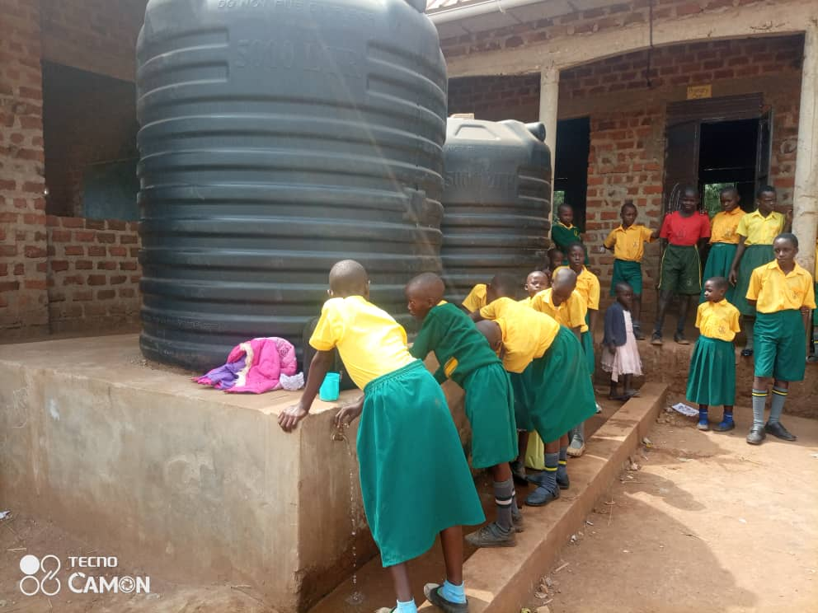
Improved Water Supply
Dug a Water well with a pumping system and installed water harvesting facilities for rain water. This has improved access to safe water by the school community.

Slide 7
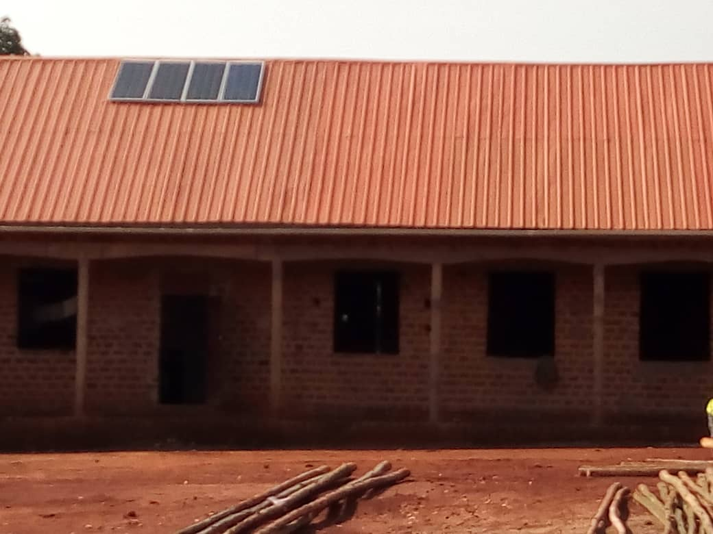
Power Installation
Solar power installation – This has provided an enabling environment for reading at night in addition to improved security

Slide 8
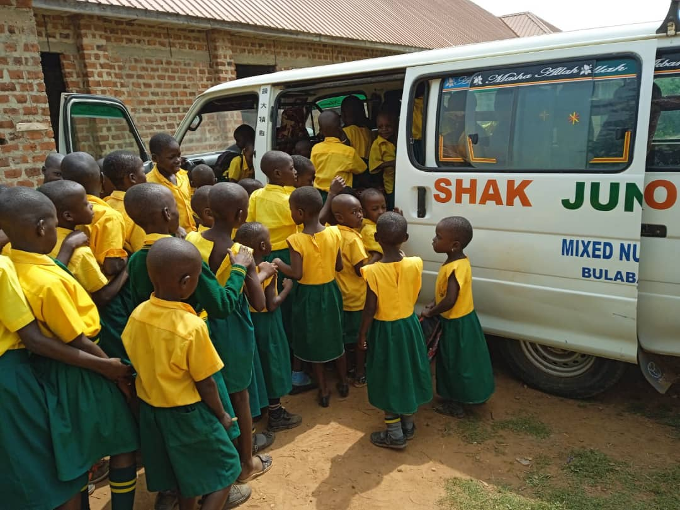
Improved transport facilities
Secured a bigger School van

Slide 9
Key Dev’ts contn
Expanded compound space
Introduced more classes from P3 in 2019 to P5 in 2022
Opened the boarding section, currently 3 learners
We are legally recognized by the government authorities and active member of the Zirobwe Private Schools Association
We have maintained a good relationship with the MoES and we actively participated in the roll out of the home learning program through distribution of learning materials to learners at home.
Our teachers were oriented on the new curriculum and our Nursery In charge ably represented us at Makerere University for the review of the ECCD framework.

Slide 10
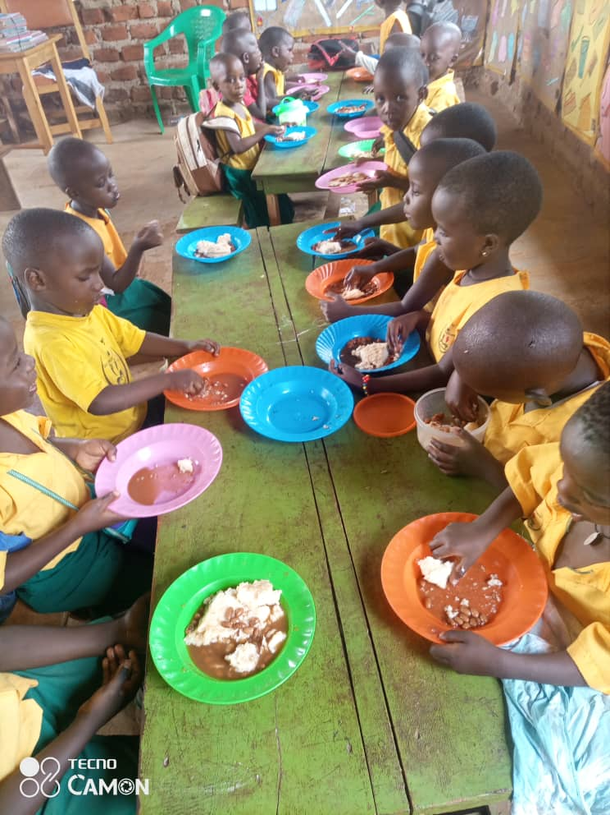
NEXT STEPS
To complete the ongoing construction phase of the nursery building, dining hall and shuttering of the old block
Improving on the play facilities especially for the nursery learners.
Construction of an improved Kitchen facility with modern cooking stoves
Deepening the water well for more retention capacity
Installation of more water tanks to maximize rain water harvesting
Expanding the boarding section/building of dormitories for both boys and girls
Construction of an extra VIP pit latrine 8 - stance

Slide 11
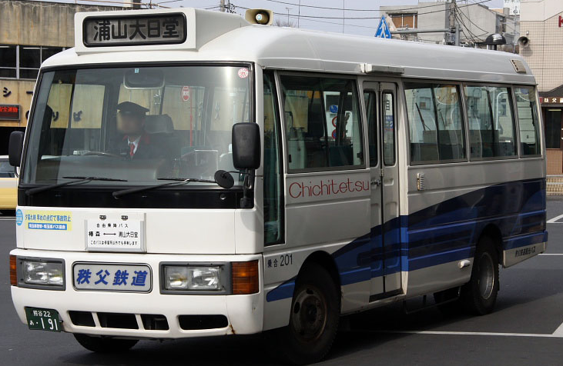
Transport and IT
Purchase of an additional van with bigger siting capacity to cope with the increased numbers in a more cost effective way
Purchase of a desktop computer and Printer /photocopier for better information processing and management
Purchase a sound system to facilitate sound based learning moments like jolly phonics, rhymes and musical back ups especially during PE and morning circles.
Constructing the School Library and Computer Lab
Proposed type of new van

Slide 12
Staff Welfare
Expansion and improvement of the Teachers’ quarters
Furnishing and equipping the teachers/staff room on the old block
Elevating the Staff salaries for better welfare and retention
Continued capacity building of staff for professional growth

Slide 13
Partnership and networking
To strengthen our link with the friends association in Germany through information sharing
Further the efforts of twinning our school with sister schools in Uganda and Germany
Lay strategies to attract more volunteers for educational, social and cultural exchange

Slide 14
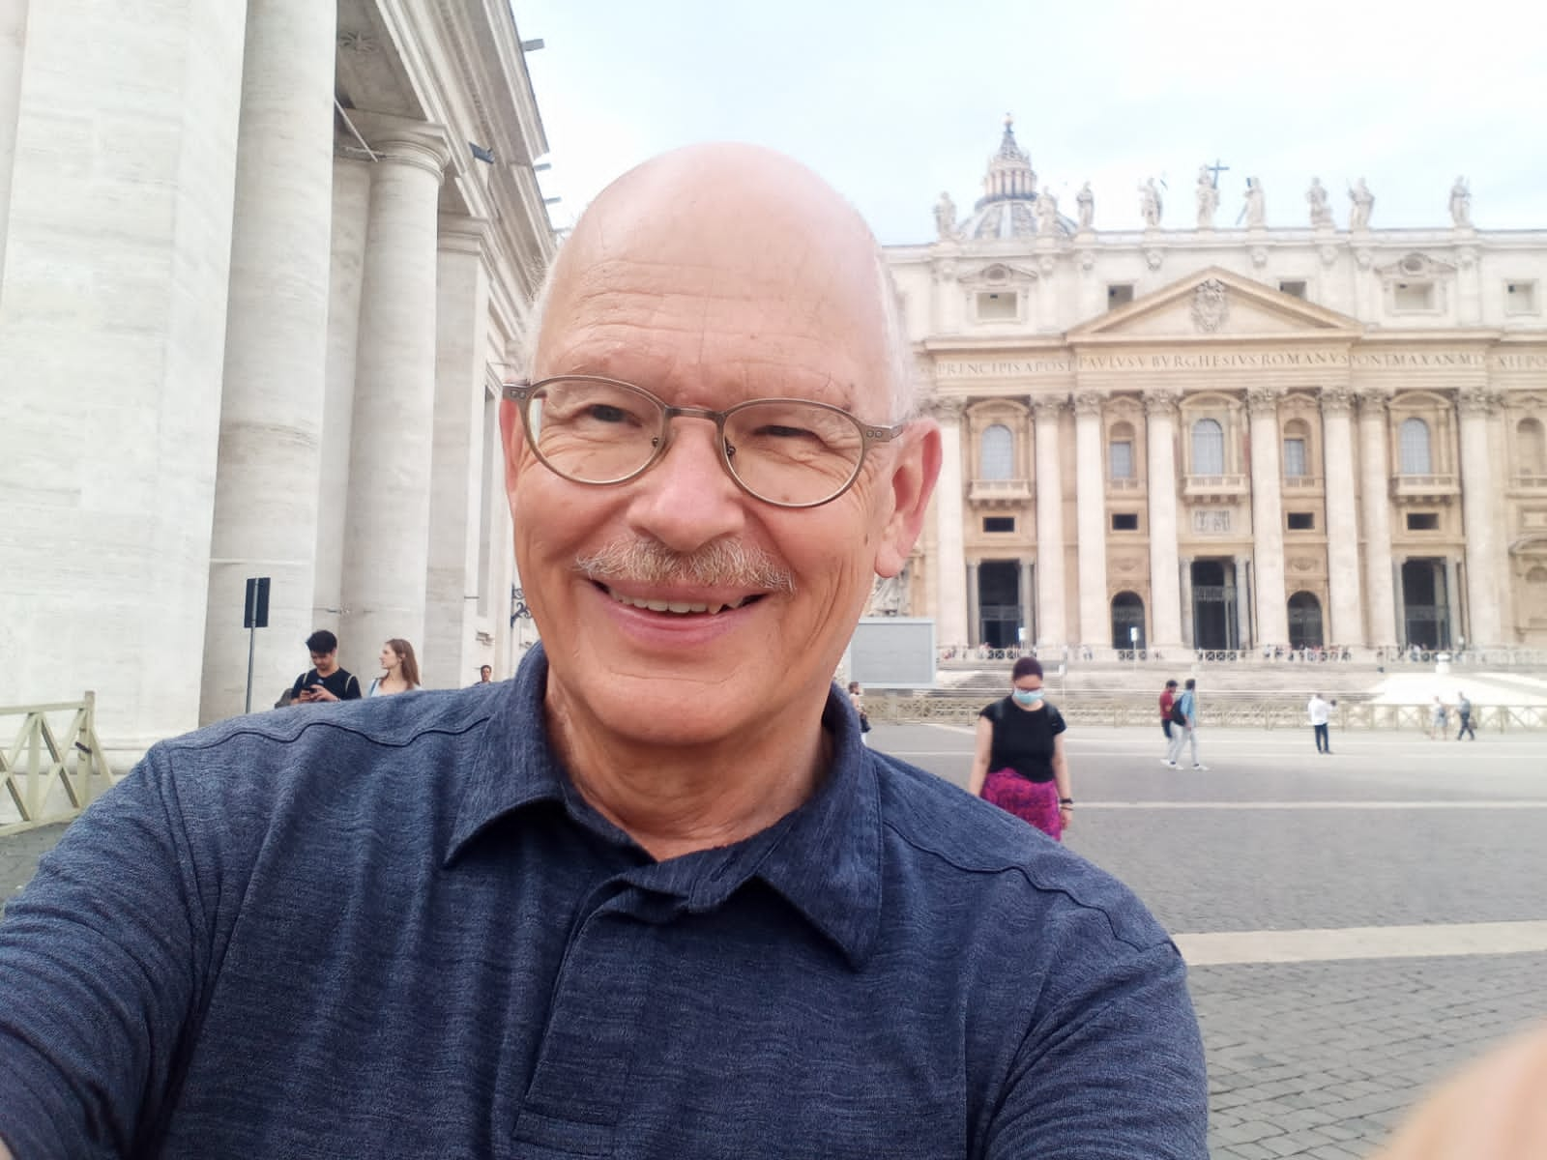
Acknowledgements
The local Community
Parents
Learners
Staff
Directors
SES
Friends and Supporters of Shak Junior School in Germany, led by Klaus Gresser

Slide 15
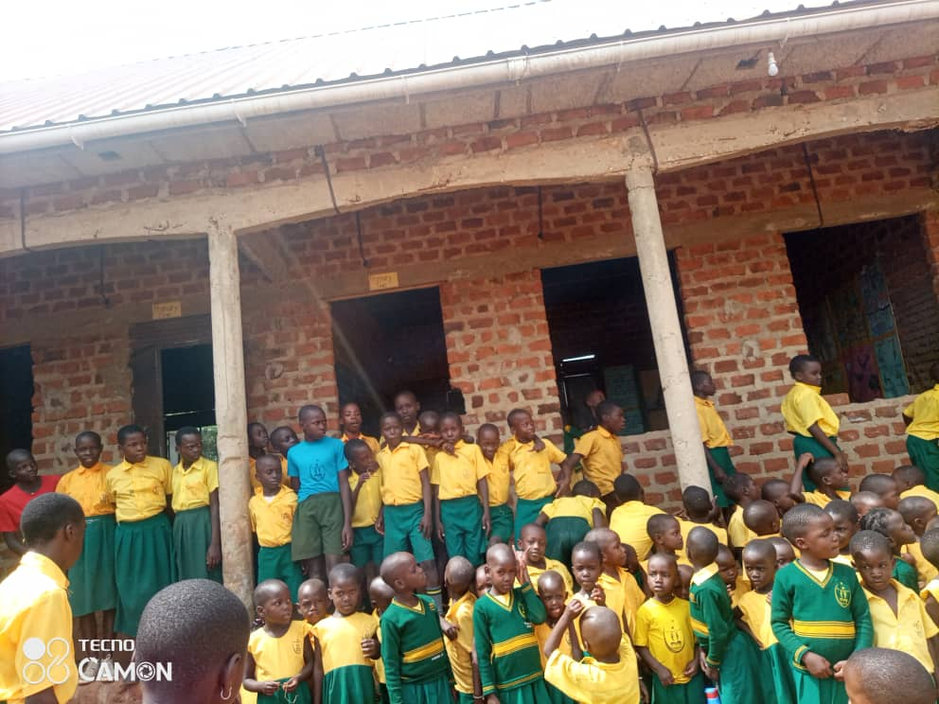
THANK YOU

